Slide 1
Chapter 4: Amino acids
By
Prof. Sanjay A. Nagdev
Dept of Quality Assurance
K.Y.D.S.C.T’s College of Pharmacy Sakegaon

Slide 2
Amino acids:
Amino acids are a group of organic compounds containing two functional groups – amino and carboxyl.
The amino group ( -NH2) is basic while the carboxyl group ( -COOH ) is acidic in nature.
The key elements of amino acid are carbon, hydrogen, oxygen, and nitrogen.
Amino acids are the basic structural building units of protein and they are also utilized as an energy source.
There are about 300 amino acids occur in nature.

Slide 3
Structure of Amino acids:
Each amino acid has 4 different groups attached to α- carbon (which is C-atom next to COOH).
These 4 groups are : amino group, COOH, Hydrogen atom and side Chain (R)

Slide 4
Classification of amino acids:
1.Aliphatic amino acids
2.Hydroxyl group containing amino acids
3.Sulfur containing amino acids
4.Acidic amino acids and their amides
5.Basic amino acids
6.Aromatic amino acids
7.Imino acids

Slide 5
1. Aliphatic amino acids:
Glycine
Alanine
Valine
Leucine
Isoleucine
Glycine alanine

Slide 6
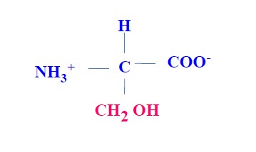
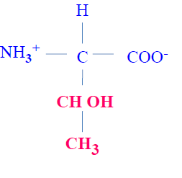
2. Hydroxyl gr. containing amino acids (-OH):
Serine
Threonine
Tyrosine
Serine Threonine

Slide 7
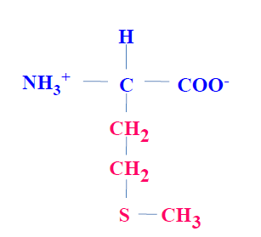
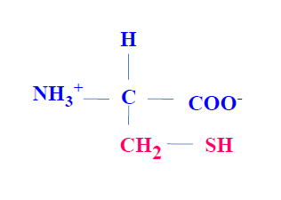
3. Sulfur containing amino acids:
Cysteine
Methionine
Cysteine Methionine

Slide 8
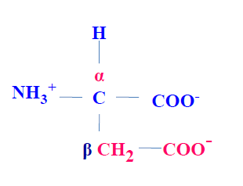
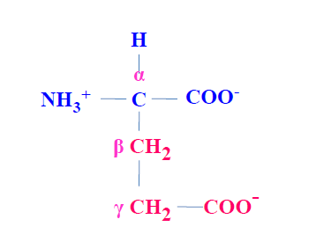
4. Acidic amino acids and their amides:
Aspartic acid
Asparagine
Glutamic acid
Glutamine
Glutamic acid Aspartic acid

Slide 9
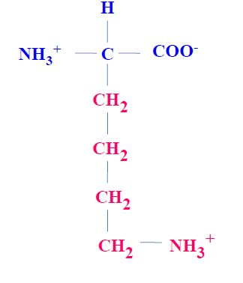
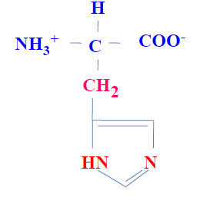
5.Basic amino acids:
Lysine
Arginine
Histidine
Lysine Histidine

Slide 10
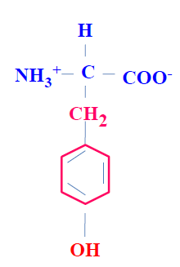
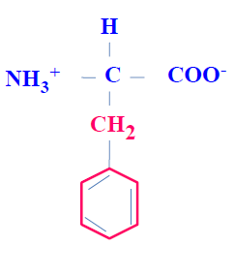
6. Aromatic amino acids:
Phenylalanine
Tyrosine
Tryptophan
Phenylalanine Tyrosine

Slide 11
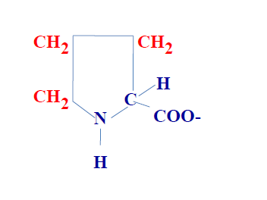
7.Imino acids :
Proline containing pyrrolidine ring is a unique amino acid.
Proline

Slide 12
Classification of amino acids based on polarity:
1. Non – polar amino acids:
e.g. glycine, alanine, leucine, isoleucine, valine, tryptophan and proline.
2. Polar amino acids with no charge on R group:
e.g. serine, cysteine, glutamine, tyrosine.
3. Polar amino acids with positive R- group:
e.g. lysine, arginine, histidine
4. Polar amino acids with negative R- group:
e.g. aspartic acid and glutamic acid

Slide 13
Essential Amino Acids:
These are the amino acids which are not synthesized in body and to be provided in the diet.
Deficiency of these amino acid may cause various disease like Nerve Breakdown, inhibition of mental growth.
E.g. Valine, Leucine, Isoleucine, Threonine, Methionine, Phenylalanine, Tryptophan and lysine

Slide 14
Semi- essential Amino acids:
These are the amino acids which are partially synthesized by the body but not in adequate amount to meet body requirement.
E.g. Arginine and histidine
Non - essential amino acids:
These are the amino acids which are syntesized in body to meet the biological needs, hence they need not be consumed in the diet.
E.g. glycine, alanine, serine, cysteine, aspartate, asparagine, glutamate, glutamine, tyrosine and proline.

Slide 15
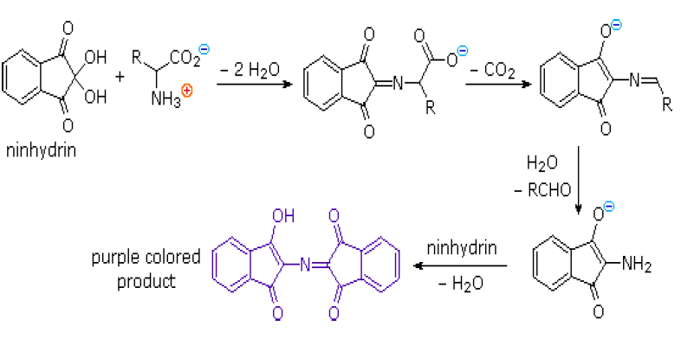
The Ninhydrin Reaction

Slide 16
The α-amino acids react with ninhydrin to form a purple complex( Ruhemanns`s purple ).
Amino acid + Ninhydrin Keto acid +Hydrindantin + NH3 + CO2
+
Ninhydrin
Ruhemanns’s purple

Slide 17
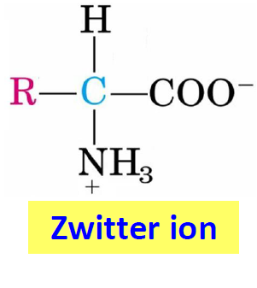
Zwitter ion or dipolar ion :
Zwitter ion is a hybrid molecule containing positive and negative ionic groups.
Each amino acid has a characteristic pH at which it carries both positive and negative charges and exists as zwitter ion.
Isoelectric pH:
it is defined as the pH at which a molecule exists as a zwitter ion or dipolar ion and carries no net charge.

